Slide 1
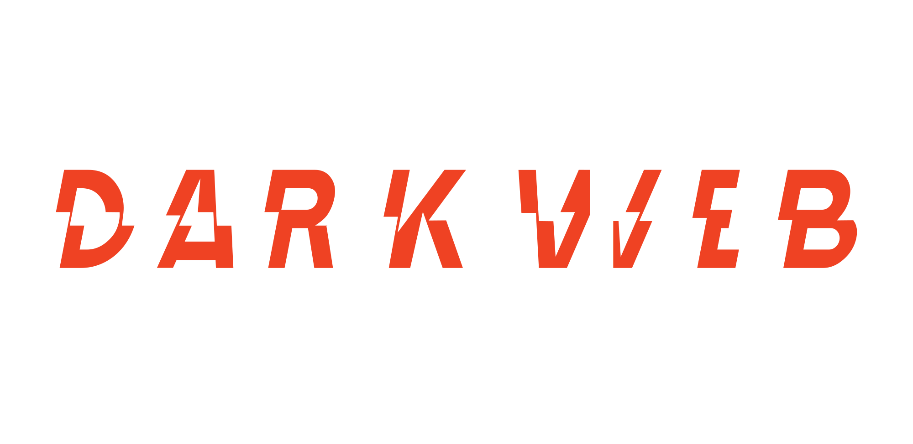
Zscaler
Operational Sync
First Offensive Cyber Solution
Infiltrate · Intervene · Intercept
CONFIDENTIAL

Slide 2
Operational Agenda
Operational Alignment
Assets Under Protection
Portfolio Protection Activity
Notification Protocols
Threat Intel Insights from the Field
1 / 12

Slide 3
Subscription Parameters
Coverage Focus
Pre-ransomware interceptions + infostealer hits
Alert Window
Pre-Ransomware Alerts for up to 15 vendors
Timeline
Intel Services initiated June 19, 2025
Current term renewal date is June 19, 2026
2 / 12

Slide 4
The Zscaler Protected Pool
650 First Party
15 Third Party
Assets currently monitored in the protected pool
Last updated 11/25
3 / 12

Slide 5
Enterprise Protection Impact
1
1
2
Infostealer Notification for Zscaler*:
August 1, 2025
Infostealer
Notification
for Vendors:
Okta - March 30th, 2026
RFI Request
Shinyhunters - 10/25
Typosquatting - 2/26
*We have had additional infostealer hits available through the platform. We only notify on one’s that pass our OSINT checks.
4 / 12

Slide 6
Secure Notification Protocols
Delivery Mechanisms
ksoncrant@zscaler.com awood@zscaler.com droberti@zscaler.com | Direct Email Notifications
ksoncrant@zscaler.com ddesai@zscaler.com bstonegross@zscaler.com awood@zscaler.com droberti@zscaler.com | Monthly Intel Reports
ksoncrant@zscaler.com ddesai@zscaler.com bstonegross@zscaler.com ckagawa@zscaler.com lbolourie@zscaler.com marksu@zscaler.com z-internal-soc@zscaler.com z-tprm@zscaler.com awood@zscaler.com droberti@zscaler.com | Access to SendSafely
Direct email notifications
Redacted reports securely delivered via SendSafely
Authorized Zscaler Recipients
5 / 12

Slide 7
February 2026 Intelligence Snapshot
Top Observed Access Types
Fortinet VPN
21%
Windows RDP / SonicWall VPN
17.7%
RD Web
8.1%
Citrix / RMM
6.5%
SSO Service
6.5%
6 / 12

Slide 8
Active Exploitation Spotlight
CVE-2026-1731 —
BeyondTrust Remote Support (Pre-Auth RCE)
Dark Web Observations
DWIQ operatives observed two Initial Access Brokers advertising access derived from exploitation of a BeyondTrust vulnerability, highly likely tied to CVE-2026-1731
One broker is a long-standing IAB monitored by DWIQ since Aug 2025 whose offered victims appear on ransomware leak sites at above-baseline rates, indicating a credible ransomware supply-chain access provider.
The broker also shared instructions for creating new administrative accounts inside the BeyondTrust application, allowing persistent access that could appear as legitimate internal users if not closely monitored.
8 / 12

Slide 9
Active Exploitation Timeline
Vendor Disclosure → Public PoC → Reconnaissance → Access Resale
Feb 6: Vendor advisory published for CVE-2026-1731
Feb 10: Public Proof-of-Concept exploit released on GitHub
Within ~24 hours: Internet-wide reconnaissance targeting BeyondTrust deployments observed
~7 days: DWIQ observed IABs marketing compromised network access
Observed Post-Compromise Tradecraft
Deployment of legitimate remote management software SimpleHelp to maintain persistence and enable lateral movement.
Defensive Signal for Insured Organizations
Organizations running externally exposed BeyondTrust Remote Support / PRA portals should prioritize:
Patch validation
Monitoring for new administrative account creation
Detection of unauthorized RMM deployment (e.g., SimpleHelp)
8 / 12

Slide 10
Platform Roadmap
Darkweb IQ
Yearly Strategic View
Feb 2026
Q4 2025 (completed)
Q1 2026 (completed)
Q1 2026 (in progress)
Q2 2026
Q3 2026 (in planning)
IAB Data Integration
API Access
Portfolio and Third-party View
Referral links
Expanding Platform datasets
Integrate Access Broker (IAB) data into the platform, making engagement and victim lists accessible to enterprises. Include threat actor credibility to help customers assess and prioritize risks. Ensure data readiness for the Portfolio and Third-party View.
Extend the current API into a customer-facing interface to support seamless automation and integration of datasets into client workflows.
Enable insurers, partners, IR firms, and brokers to access partial datasets for portfolio and third-party exposure assessments. Deliver reports enriched with indicators of compromise (IOCs) to support risk mitigation and lead generation.
Introduce referral functionality, allowing third parties to register on behalf of customers and access relevant data and IOCs. Convert leads into paying customers by streamlining access and demonstrating value.
Adding new datasets to expand platform coverage and capabilities (e.g., CVE tracking, ransomware posts/events), enabling stronger risk management across first- and third-party modules.
Support for Reports
Risk scoring
Develop a unified risk-scoring framework that combines all datasets to assess exposure severity and prioritize remediation.
Platform-hosted repository for internally generated reports.

Slide 11
Implications for Enterprise Infrastructure
The Primary Target
The Rising Threat
VPN appliances remain the dominant monetization target for threat actors.
Identity-layer compromise (specifically SSO) is rapidly increasing in relevance.
The Lateral Enabler
The Perimeter Risk
RDP exposure continues to be the primary vehicle for lateral network movement.
Network-edge devices are consistently prioritized by Initial Access Brokers (IABs).
7 / 12

Slide 12
The Initial Access Broker Ecosystem
Exploit
Package
Sell
Deploy
Vulnerability in edge device or app
IAB bundles access with victim details
Ransomware affiliate purchases access
Ransomware hits within 1–14 days
$500 – $50K+
VPN + RDP
1 – 14 days
Typical asking price per access
Most commonly brokered access types
Avg time from sale to ransomware
IABs are the upstream supply chain for ransomware — they enable attacks at scale.

Slide 13
Where DWIQ Intercepts the Kill Chain
Exploit
Package
Sell
Deploy
Vulnerability in edge device or app
IAB bundles access with victim details
Ransomware affiliate purchases access
Ransomware hits within 1–14 days
DWIQ INTERCEPTION ZONE
How We Get There
What You Get
1-on-1 relationships with IABs via misattributable personas
Analyst-vetted alerts before ransomware deploys
Direct engagement — not marketplace scraping
Actionable time to patch, isolate, or rotate credentials

Slide 14
Active Exploitation Spotlight: Fortinet
CVE-2024-55591 — Authentication Bypass
Dark Web Observations
IABs are claiming active exploitation in the wild.
Intercepted screenshots suggest actors are achieving admin account creation directly via the FortiOS interface.
Historically linked to major ransomware operations, including Qilin and Mora_001.
Remains a highly discussed exploit throughout January 2026.
8 / 12

Slide 15
Broader CVE Exploitation Chatter
Actors discussed or offered exploitation involving:
CVE-2025-20354
CVE-2024-3400
Cisco
Palo Alto PAN-OS
CVE-2025-55182
CVE-2025-58034 / 64446
React/Next.js — Pre-auth RCE
Fortinet FortiWeb
CVE-2025-62215
Windows Kernel LPE
9 / 12

Slide 16
Identified Actor Attack Patterns
Target Profile
Tooling
The vast majority of focus is on unauthenticated, network-exposed vulnerabilities.
Public Proof of Concepts (PoCs) are frequently and rapidly leveraged.
Strategy
Market Dynamics
Actors favor opportunistic exploitation over deploying novel zero-days.
Despite specific CVE chatter, there is no proportional overall spike in exploit-based access listings on the market.
10 / 12

Slide 17
Continuous Offensive Posture
Infiltrate. Intervene.
Intercept.
Actively securing the ACME portfolio against emerging threats.
DARKWEB IQ
12 / 12

